Slide 1
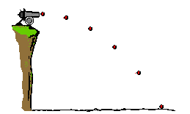
PROJECTILE MOTION (HORIZONTAL)

Slide 2

DESCRIBING MOTION
We already have a number of equations that we can use to describe motion; mostly, they revolve around energy and force:
$$E_{K}=\frac{1}{2}mv^{2}$$
$$E_{P}=mgh$$
$$W=Fs= ∆E$$
$$F=ma$$
Etc…

Slide 3

DESCRIBING MOTION
However, if we want to calculate the speed, position, acceleration or time-of-travel of an object, we need to use kinematic equations, hereafter referred to as the equations of motion:
$$a=\frac{v−u}{t} or v=u+at$$
$$s=ut+\frac{1}{2}at^{2}$$
$$v^{2}=u^{2}+2as$$
a = acceleration (m/s²)
v = final velocity (m/s)
u = initial velocity (m/s)
t = time (s)
s = displacement (m)
*Recall that all vector quantities require a direction, usually given as either +ve or –ve.

Slide 4

EQUATION 1 - REVIEW
Example 1: A car goes from rest to 30m/s in 9 seconds of constant acceleration. Find the acceleration:
$$a=\frac{v−u}{t}$$
$$a=\frac{30−0}{9}$$
$$a=3.33 m/s^{2}$$

Slide 5

EQUATION 1 - REVIEW
Example 2: A car accelerates from rest at 2 m/s² for 10 seconds. Find the final speed:
$$v=u+at$$
$$v=0+2\left(10\right)$$
$$v=20 m/s$$

Slide 6

EQUATION 1 - REVIEW
Example 3: A car reaches 20 m/s after accelerating at 2 m/s² for 3 seconds. Find the initial speed:
$$u=v−at$$
$$u=20−2\left(3\right)$$
$$u=14 m/s$$

Slide 7

EQUATION 1 - REVIEW
Example 4: A car reaches 30 m/s after accelerating at 3 m/s² from rest. Find the time taken to reach this final speed:
$$t=\frac{v−u}{a}$$
$$t=\frac{30−0}{3}$$
$$t=10 s$$

Slide 8

EQUATION 2 - REVIEW
Example 5: A car travelling at 10 m/s accelerates at 5 m/s² for 4 seconds. Find the distance travelled in this time:
$$s=ut+\frac{1}{2}at^{2}$$
$$s=10(4)+\frac{1}{2}(5){(4)}^{2}$$
$$s=80 m$$

Slide 9
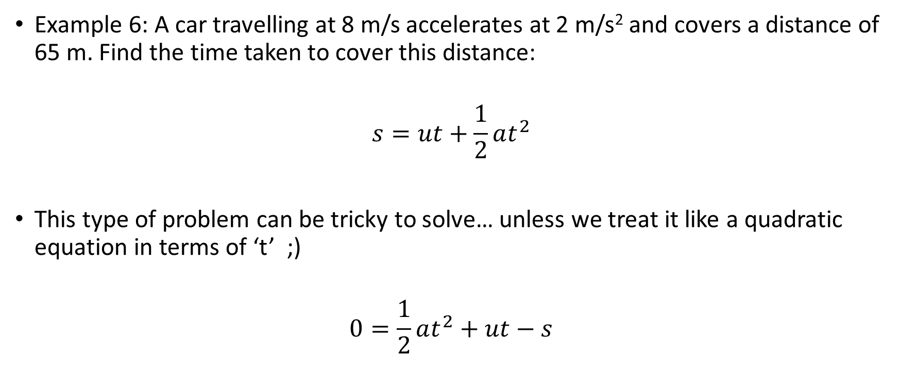
EQUATION 2 - REVIEW
Example 6: A car travelling at 8 m/s accelerates at 2 m/s² and covers a distance of 65 m. Find the time taken to cover this distance:
$$s=ut+\frac{1}{2}at^{2}$$
This type of problem can be tricky to solve… unless we treat it like a quadratic equation in terms of ‘t’ ;)
$$0=\frac{1}{2}at^{2}+ut−s$$

Slide 10
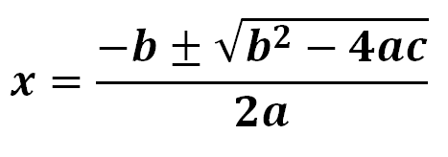

EQUATION 2 - REVIEW
$$0=\frac{1}{2}at^{2}+ut−s$$
Recall: The Quadratic Formula
Where…
$a= \frac{1}{2}a$, $b=u$, $c=−s$, $x=t$
So…
$$t=\frac{−u±\sqrt{u^{2}+2as}}{a}$$

Slide 11
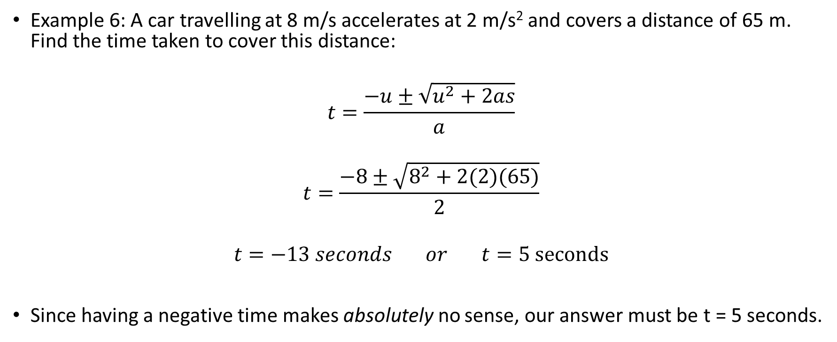
EQUATION 2 - REVIEW
Example 6: A car travelling at 8 m/s accelerates at 2 m/s² and covers a distance of 65 m. Find the time taken to cover this distance:
$$t=\frac{−u±\sqrt{u^{2}+2as}}{a}$$
$$t=\frac{−8±\sqrt{8^{2}+2(2)(65)}}{2}$$
$$t=−13 seconds or t=5 seconds$$
Since having a negative time makes absolutely no sense, our answer must be t = 5 seconds.

Slide 12

EQUATION 3 - REVIEW
Example 7: A car travelling at 5 m/s accelerates at 4 m/s² over a distance of 20 m. Find the final speed:
$$v^{2}=u^{2}+2as$$
$$v^{2}=5^{2}+2\left(4\right)\left(20\right)$$
$$v^{2}=185$$
$$v=13.6 m/s$$

Slide 13
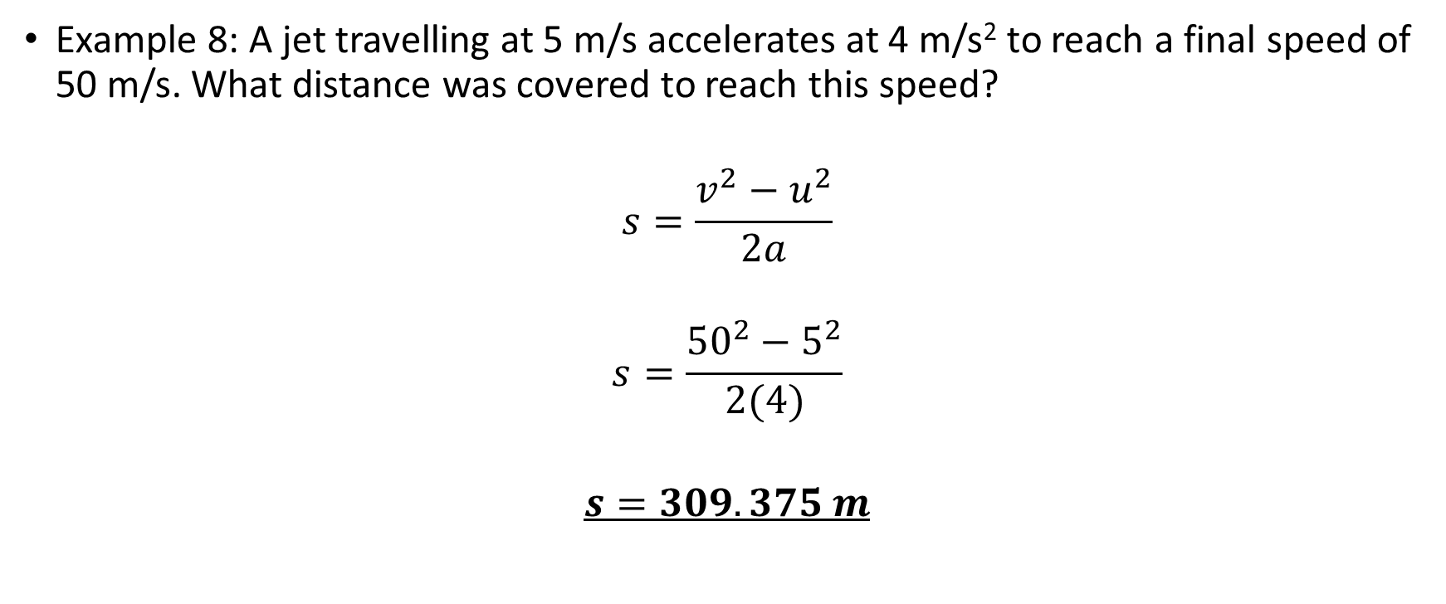
EQUATION 3 - REVIEW
Example 8: A jet travelling at 5 m/s accelerates at 4 m/s² to reach a final speed of 50 m/s. What distance was covered to reach this speed?
$$s=\frac{v^{2}−u^{2}}{2a}$$
$$s=\frac{{50}^{2}−5^{2}}{2(4)}$$
$$s=309.375 m$$

Slide 14
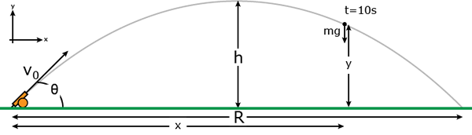
PROJECTILE MOTION
Obviously, there are other ways to rearrange and apply these equations, but the best way is simply to try solving these problems for yourself.
These equations can be applied to projectile motion problems too.

Slide 15
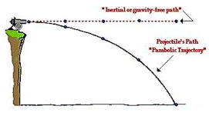
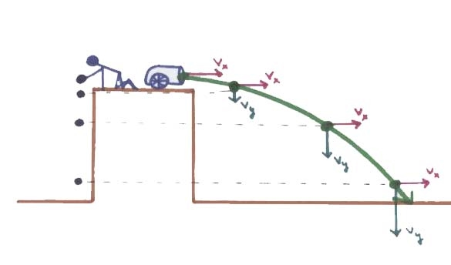
INERTIA & GRAVITY
Inertia is the tendency of an object to keep doing what it is doing (until acted upon by an unbalanced force). Projectiles tend to move in the horizontal plane at a constant velocity due to their inertia (unless friction/air resistance becomes significant – usually we ignore this).
Projectiles are also affected by gravity, causing them to accelerate in the vertical plane, directly downwards (towards the centre of the Earth).
Even though the vertical & horizontal motion function independently of one another, the result of this combined horizontal and vertical motion is projectile motion.

Slide 16
SOLVING PROBLEMS
There is often more than one approach to solving projectile motion questions. Learning how to ‘get good’ at solving these problems is not so much about ‘learning how to do the question’, but rather learning the variety of tools and techniques at your disposal so that you have multiple options when approaching new questions.
Let’s look at an example.

Slide 17
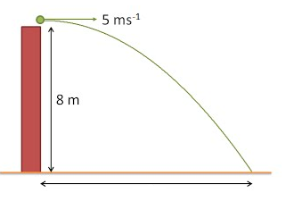
EXAMPLE
Q: A projectile is launched directly off of the edge of cliff that is 8 m high. Its’ initial velocity is 5 m/s. Assume no air resistance.
Find the horizontal distance (s_{H}) travelled (assume no bounce on landing).
Find Time of Flight (T.o.F.) (t).
Find final velocity upon landing (v).
In order to solve this problem, we will utilise the equations of motion. While we do this, we must take into account the vector nature of this problem.
Also, we don’t necessarily have to complete these questions in order – complete them in whatever order makes the most sense (although this does not apply in tests and exams).
s_{H}

Slide 18
EXAMPLE
*Break into horizontal and vertical components:
s_{H}
Horizontal:
u_{H} = 5 m/s
v_{H} = 5 m/s
a_{H} = 0 m/s²
s_{H} = ?
t = ?
Vertical:
u_{V} = 0 m/s
v_{V} = ?
a_{V} = 9.8 m/s²
s_{V} = 8 m
t = ?
As there is no acceleration, this doesn’t change.
Gravity (duh!)
This is not explicitly stated, but is obvious from wording and context of question.
No air resistance, no forces acting horizontally.
Same for both dimensions.

Slide 19
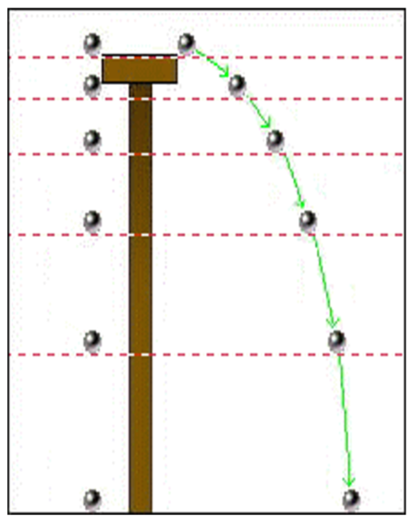

Slide 20
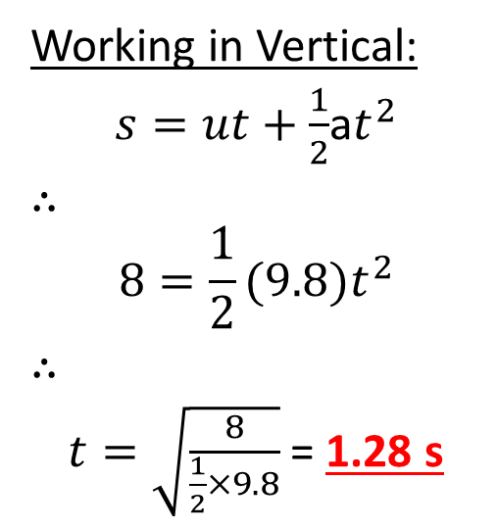
EXAMPLE
*Break into horizontal and vertical components:
*We don’t have enough information to find s_{H} yet, but if we find ‘t’ first then we shall, so let’s do that.
s_{H}
Horizontal:
u_{H} = 5 m/s
v_{H} = 5 m/s
a_{H} = 0 m/s²
s_{H} = ?
t = ?
Vertical:
u_{V} = 0 m/s
v_{V} = ?
a_{V} = 9.8 m/s²
s_{V} = 8 m
t = ?
Working in Vertical:
$s=ut+\frac{1}{2}$a$t^{2}$
∴
$$8=\frac{1}{2}(9.8)t^{2}$$
∴
$t=\sqrt{\frac{8}{\frac{1}{2}×9.8}}$ = 1.28 s
0

Slide 21

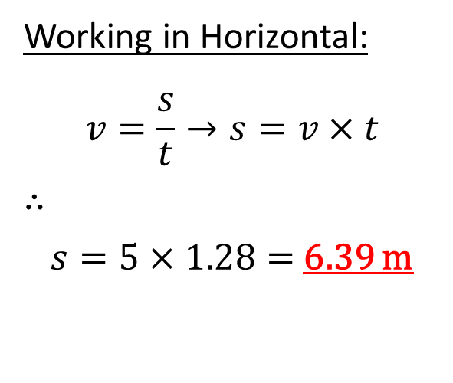
EXAMPLE
*Now, let’s find s_{H}
s_{H}
Horizontal:
u_{H} = 5 m/s
v_{H} = 5 m/s
a_{H} = 0 m/s²
s_{H} = ?
t = 1.28 s
Vertical:
u_{V} = 0 m/s
v_{V} = ?
a_{V} = 9.8 m/s²
s_{V} = 8 m
t = 1.28 s
Working in Vertical:
$s=ut+\frac{1}{2}$a$t^{2}$
∴
$$8=\frac{1}{2}(9.8)t^{2}$$
∴
$t=\sqrt{\frac{8}{\frac{1}{2}×9.8}}$ = 1.28 s
Working in Horizontal:
$$v=\frac{s}{t}→s=v×t$$
∴
$s=5×1.28=$ 6.39 m
0

Slide 22
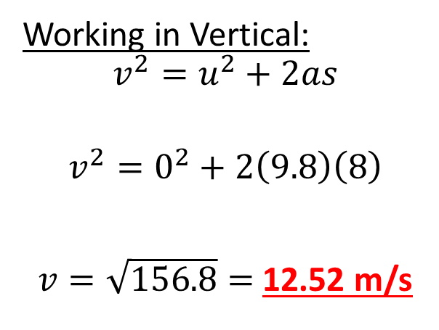
EXAMPLE
*Now, let’s find v…
We should start by finding v_{V} :
s_{H}
Horizontal:
u_{H} = 5 m/s
v_{H} = 5 m/s
a_{H} = 0 m/s²
s_{H} = 6.39 m
t = 1.28 s
Vertical:
u_{V} = 0 m/s
v_{V} = ?
a_{V} = 9.8 m/s²
s_{V} = 8 m
t = 1.28 s
Working in Vertical:
$$v^{2}=u^{2}+2as$$
$$v^{2}=0^{2}+2\left(9.8\right)\left(8\right)$$
$v=\sqrt{156.8}=$ 12.52 m/s

Slide 23
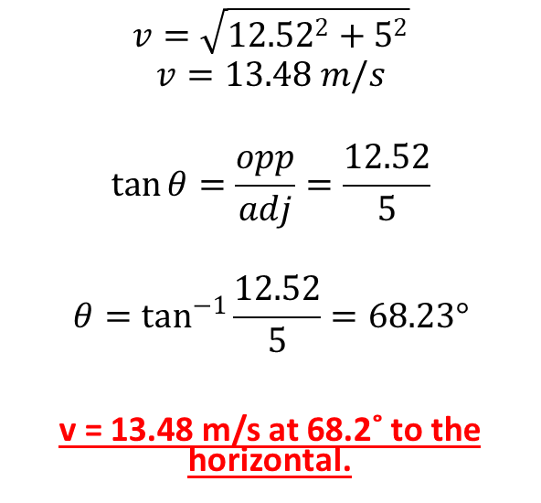
EXAMPLE
*Now, we can find v…
*Recall that ‘v’ is a vector quantity, meaning we
must solve for both magnitude and direction.
v
s_{H}
Horizontal:
u_{H} = 5 m/s
v_{H} = 5 m/s
a_{H} = 0 m/s²
s_{H} = 6.39 m
t = 1.28 s
Vertical:
u_{V} = 0 m/s
v_{V} = 12.52 m/s
a_{V} = 9.8 m/s²
s_{V} = 8 m
t = 1.28 s
$$v=\sqrt{{12.52}^{2}+5^{2}}$$
$$v=13.48 m/s$$
$$\tan{θ=\frac{opp}{adj}=\frac{12.52}{5}}$$
$$θ=\tan^{−1}{\frac{12.52}{5}=68.23°}$$
v = 13.48 m/s at 68.2˚ to the horizontal.
v
v_{V} = 12.52 m/s
θ
v_{H} = 5 m/s

Slide 24
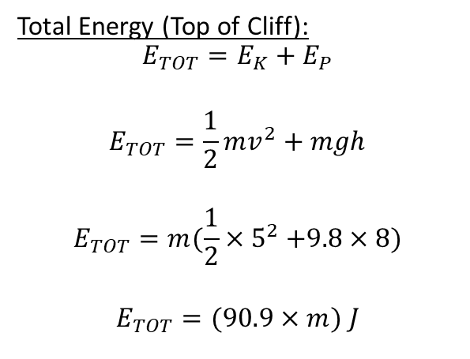
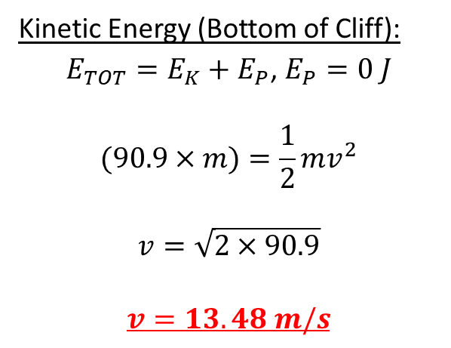
EXAMPLE
*There is actually another way to find the
magnitude of v (although the rest of the
working remains the same). This method involves
applying the Law of Conservation of Energy.
s_{H}
Horizontal:
u_{H} = 5 m/s
v_{H} = 5 m/s
a_{H} = 0 m/s²
s_{H} = 6.39 m
t = 1.28 s
Vertical:
u_{V} = 0 m/s
v_{V} = ?
a_{V} = 9.8 m/s²
s_{V} = 8 m
t = 1.28 s
Total Energy (Top of Cliff):
$$E_{TOT}=E_{K}+E_{P}$$
$$E_{TOT}=\frac{1}{2}mv^{2}+mgh$$
$$E_{TOT}=m(\frac{1}{2}{×5}^{2}+9.8×8)$$
$$E_{TOT}=(90.9×m) J$$
Kinetic Energy (Bottom of Cliff):
$E_{TOT}=E_{K}+E_{P}$, $E_{P}=0 J$
$$(90.9×m)=\frac{1}{2}mv^{2}$$
$$v=\sqrt{2×90.9}$$
$$v=13.48 m/s$$

